Slide 1










BUSINESS INSIGHTS
360
UNLEASHING THE POWER OF DATA:
INSIGHTS THAT INFORM AND INSPIRE
pawanyadav273life273@gmail.com
pawan-yadav-data

Slide 2
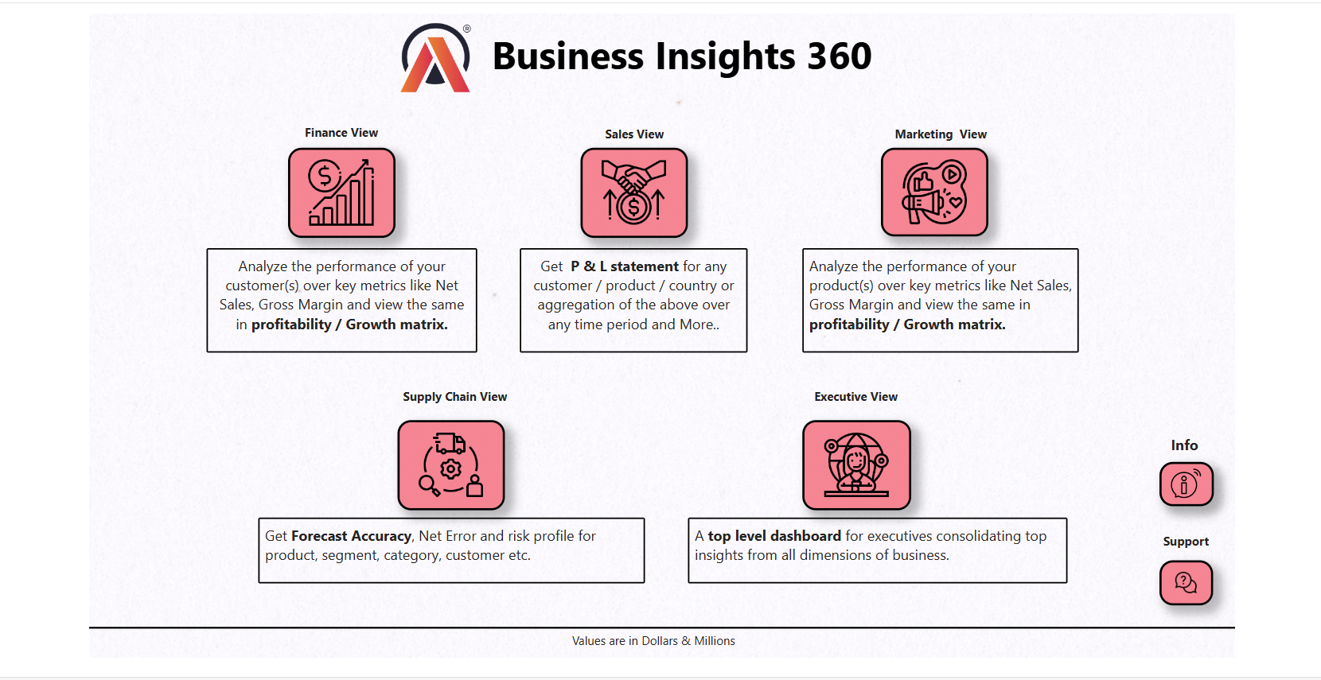

Slide 3
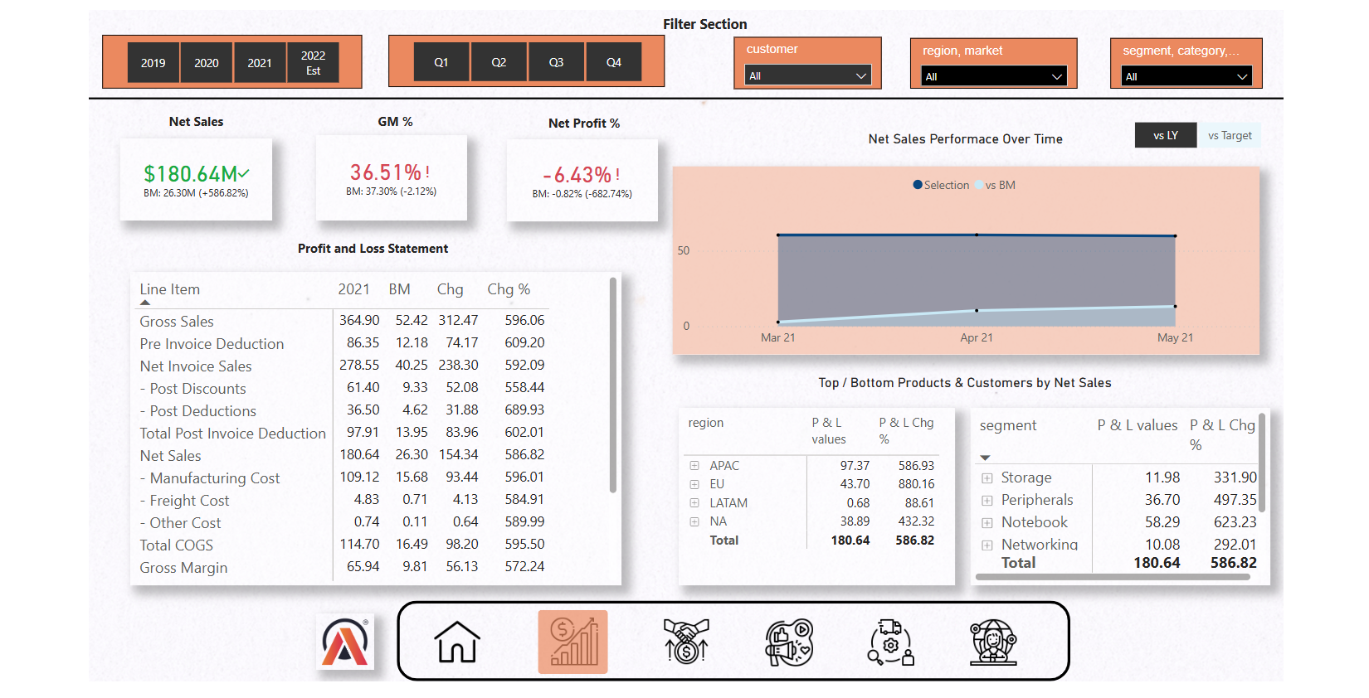

Slide 4
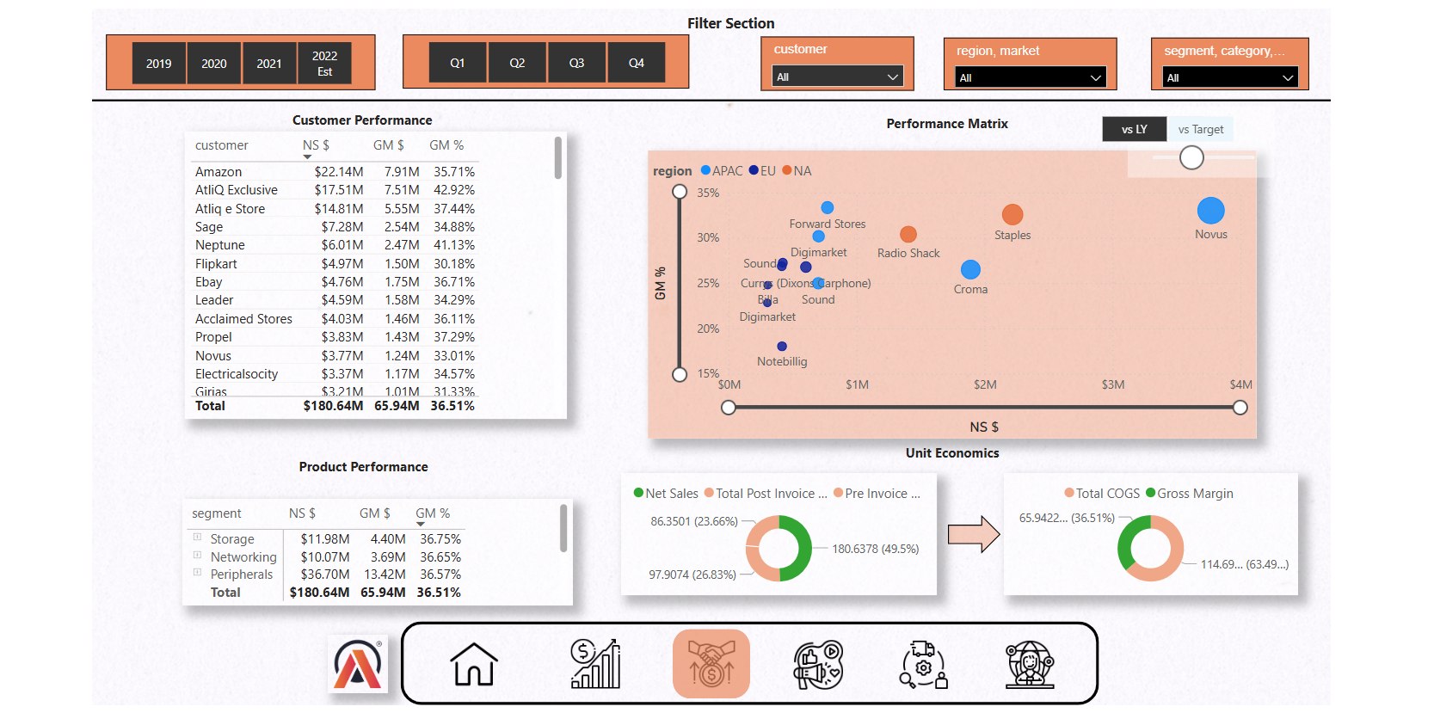

Slide 5
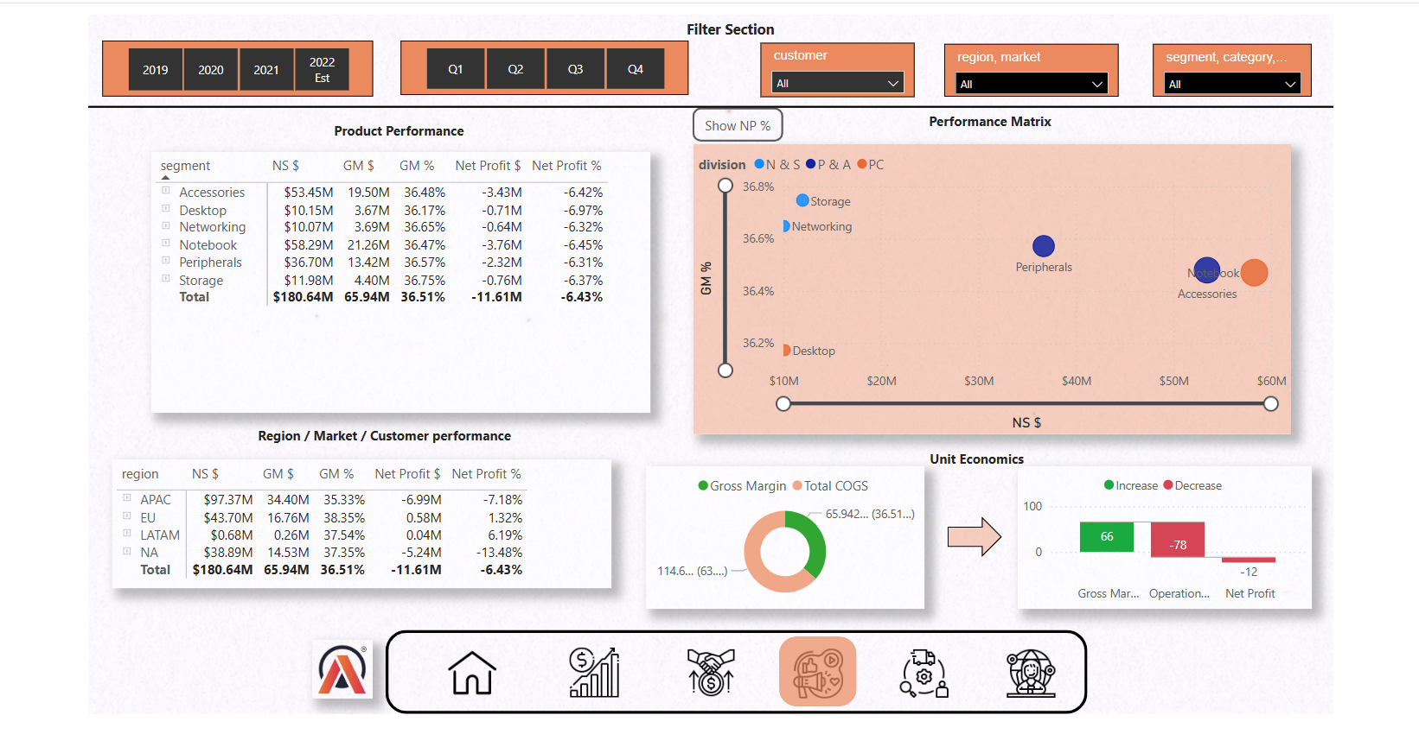

Slide 6
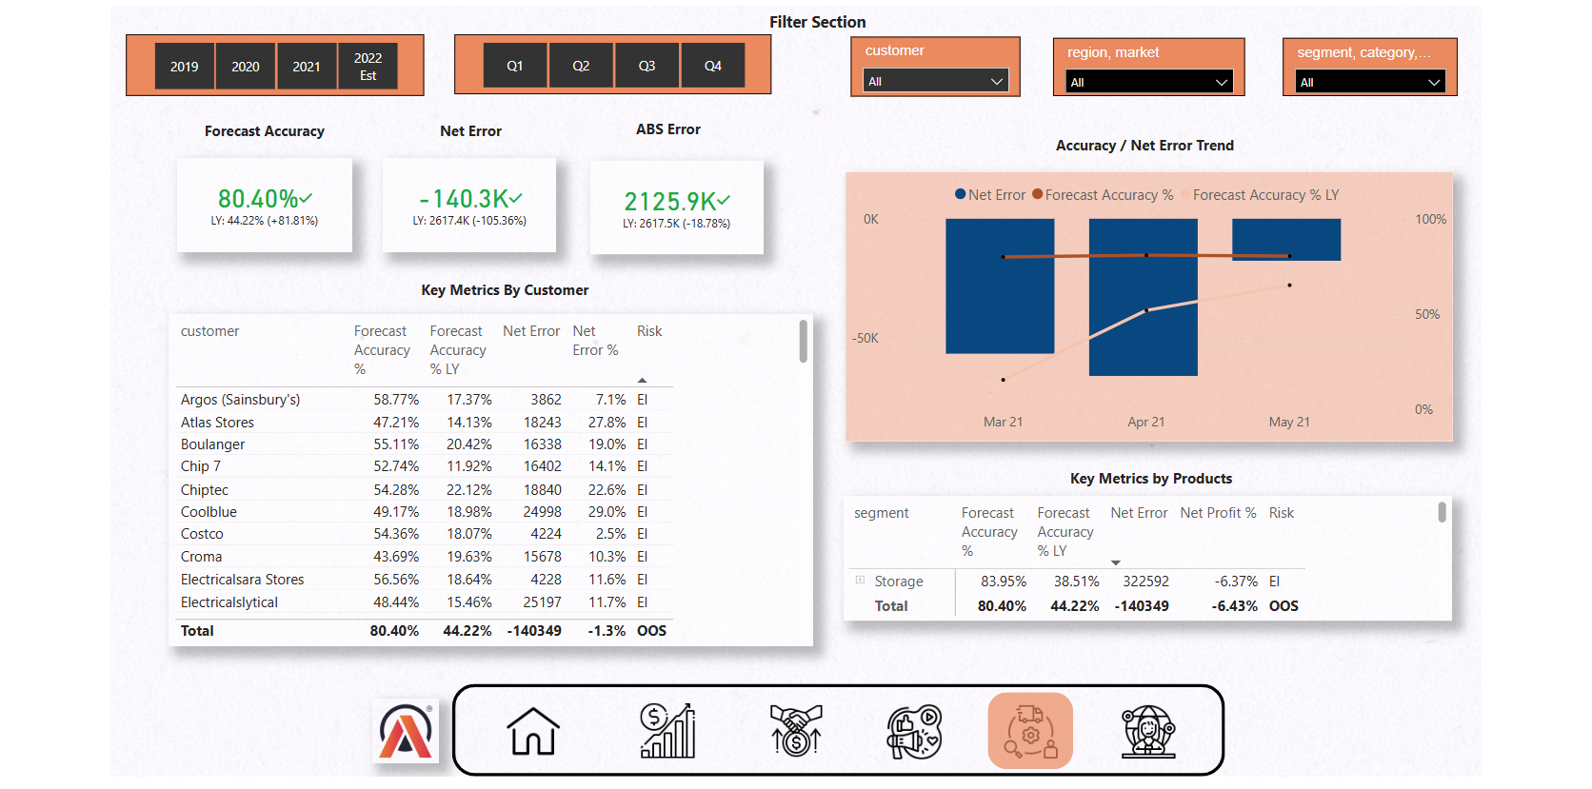

Slide 7
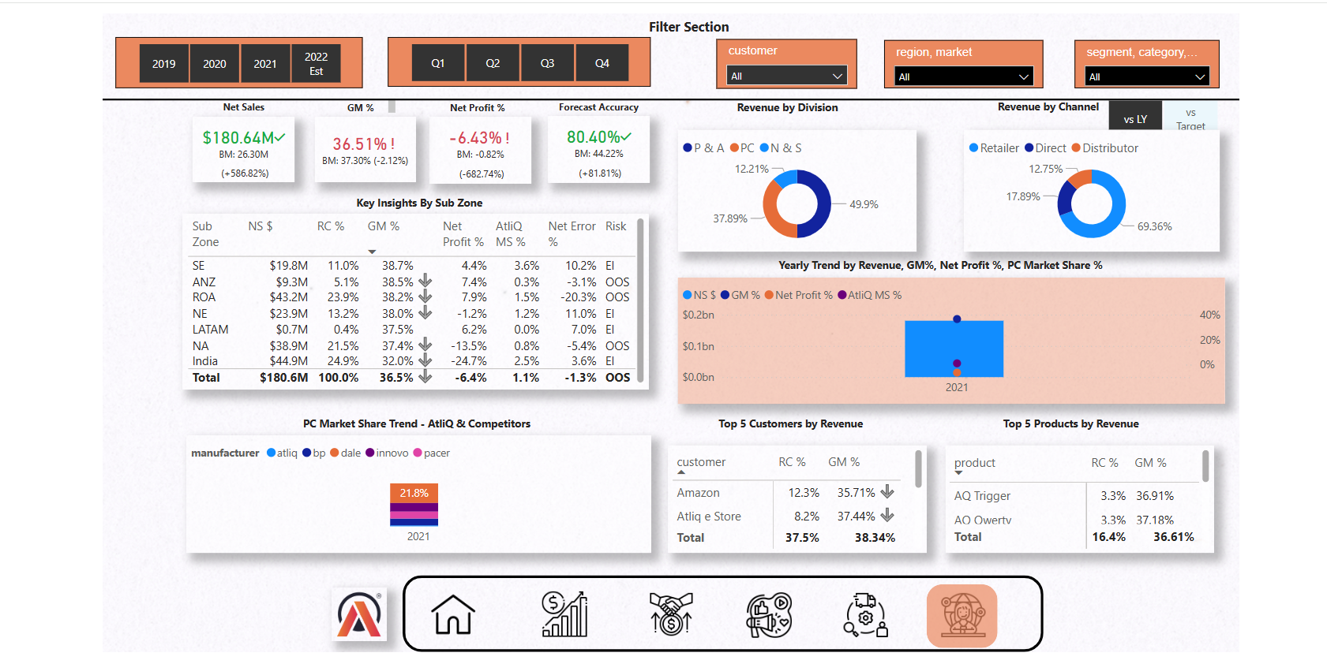

Slide 8
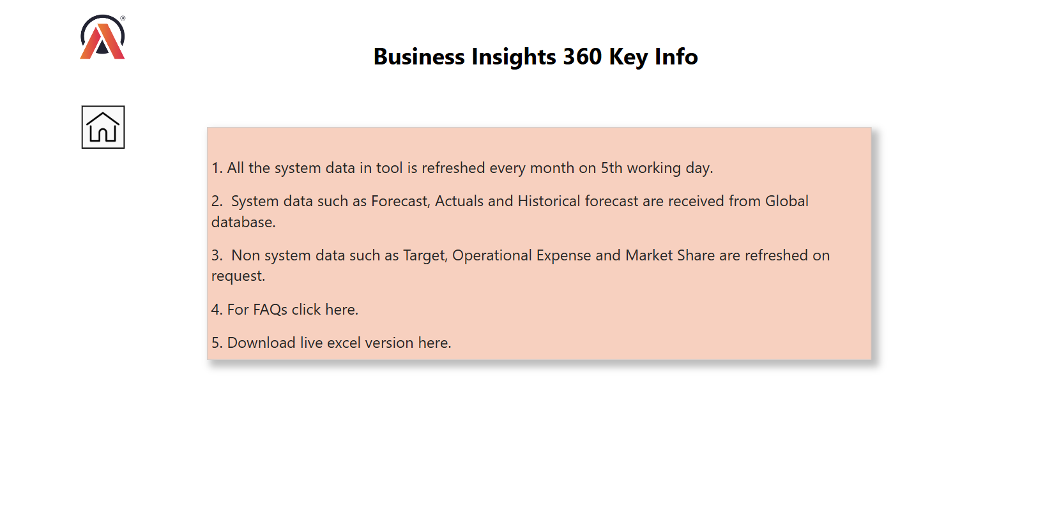

Slide 9
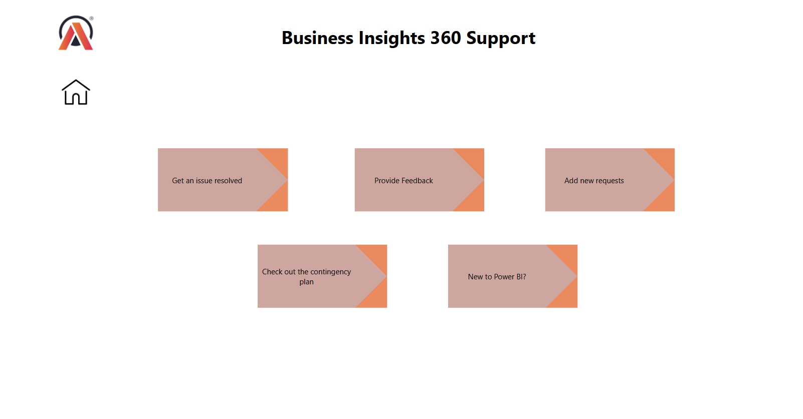

Slide 10

Live Dashboard Link
Click here to Access Live Dashboard

Slide 11

Project Walkthrough Video
Click here to Access Project overview video

